Slide 1
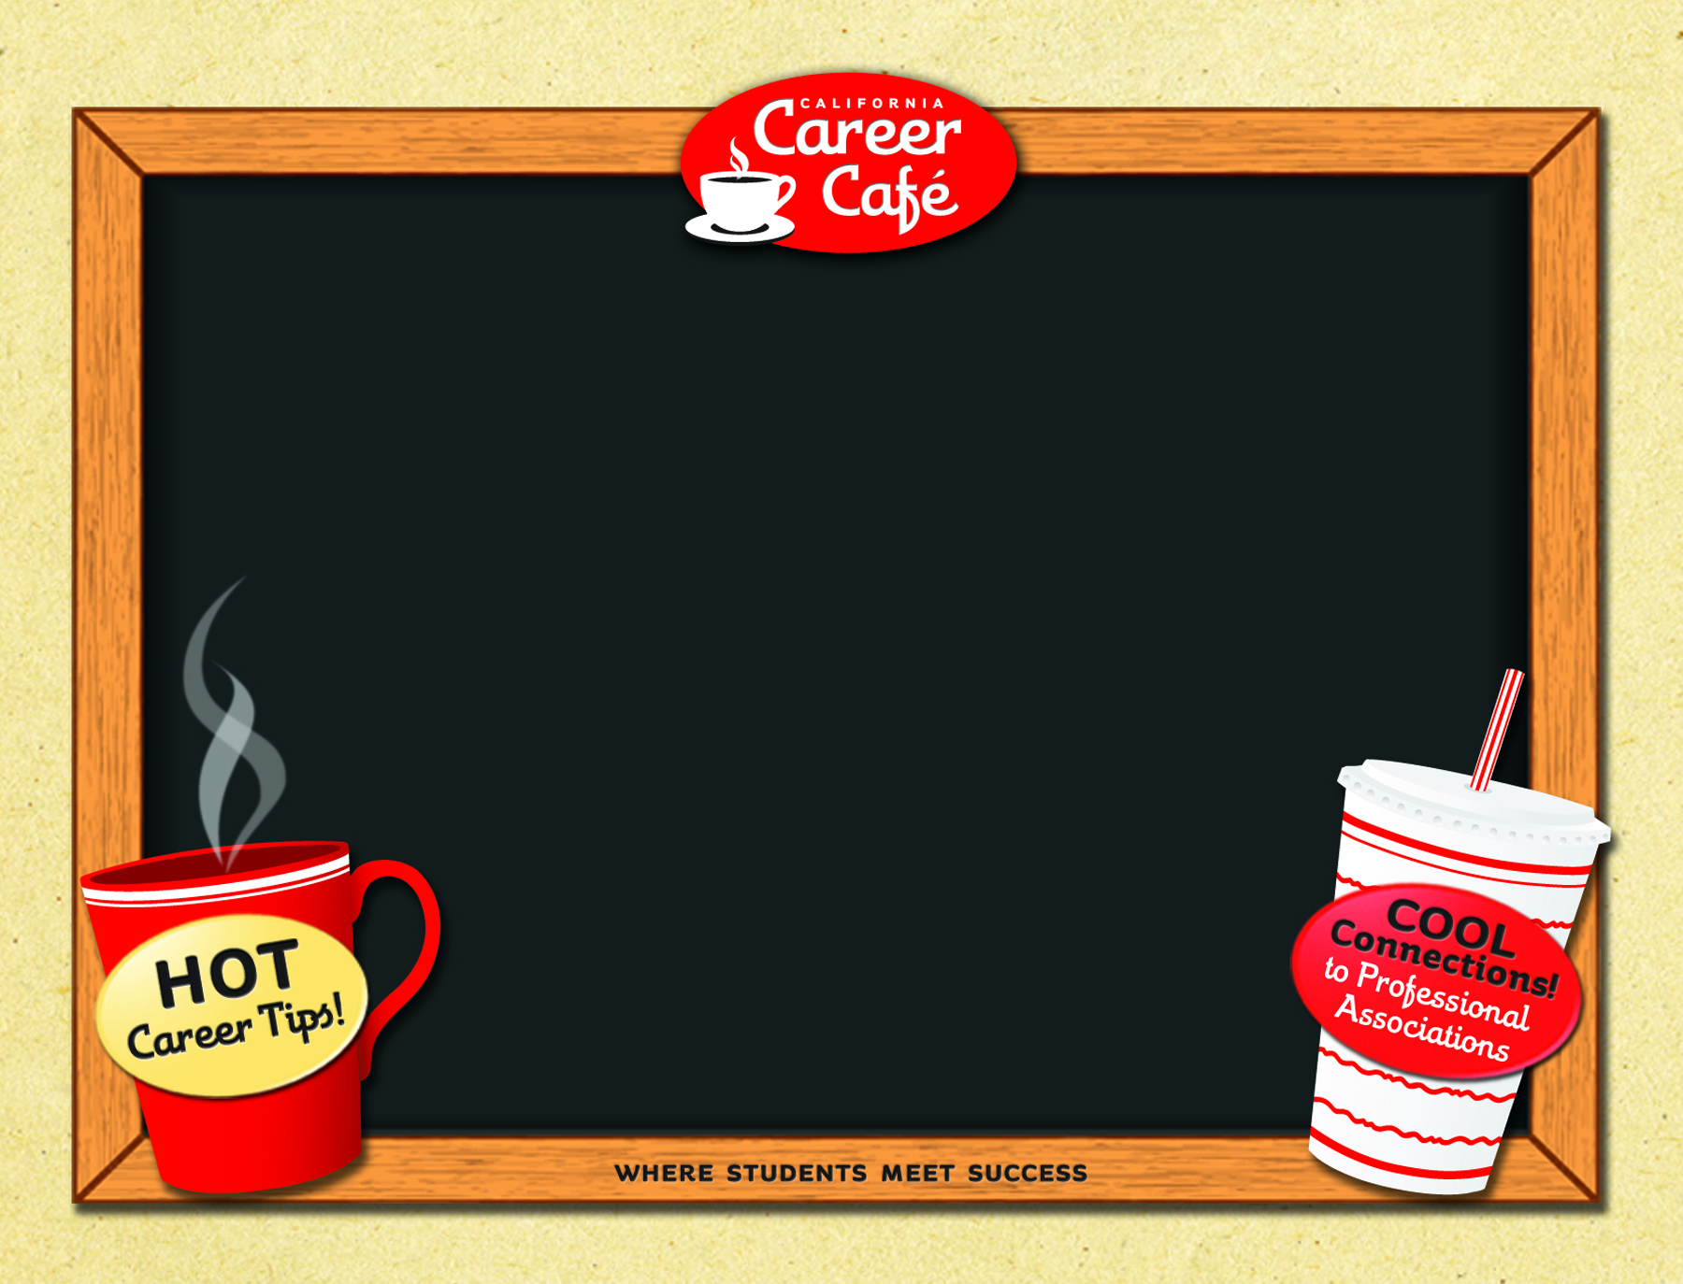
Welcome to the
CA Career Café
Presented by
Susan Coleman
and
Rita Jones
Notes:
Welcome to the grand opening of the new California Career Café website.
We are delighted to be with you today to introduce you to the site…
where students meet success.

Slide 2
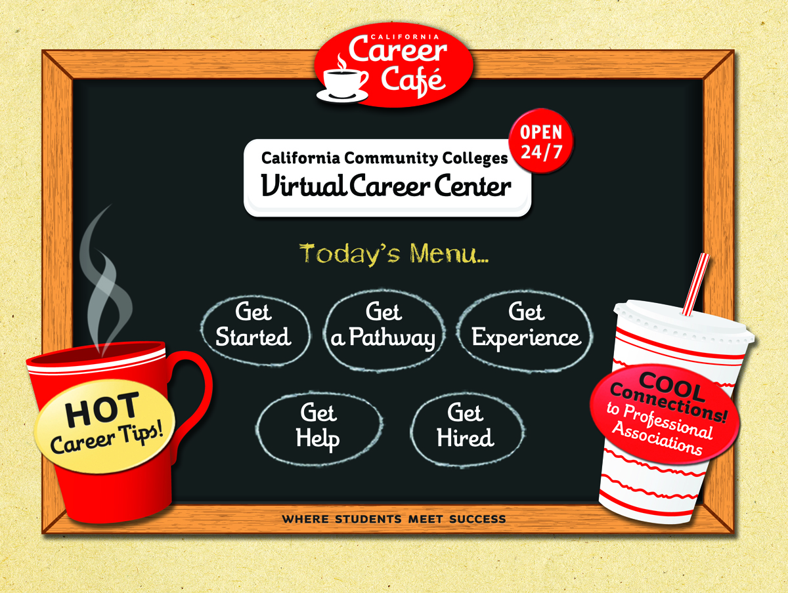
Notes:
The Career Café offers a diverse and appealing menu to help students find their best career direction. Whether students are just starting out, returning Veterans, or making a career change, the Career Café can them get where they want to go.

Slide 3
Warm & friendly Café environment
Created to serve all CCC Students
Developed with funding from
SB70, AB1133
Irvine Valley College, Fiscal Agent
Notes:
The café theme was chosen for this site because it is one all our students can relate to.
It helps establish a welcoming feeling as soon as the students arrive at the home page.

Slide 4
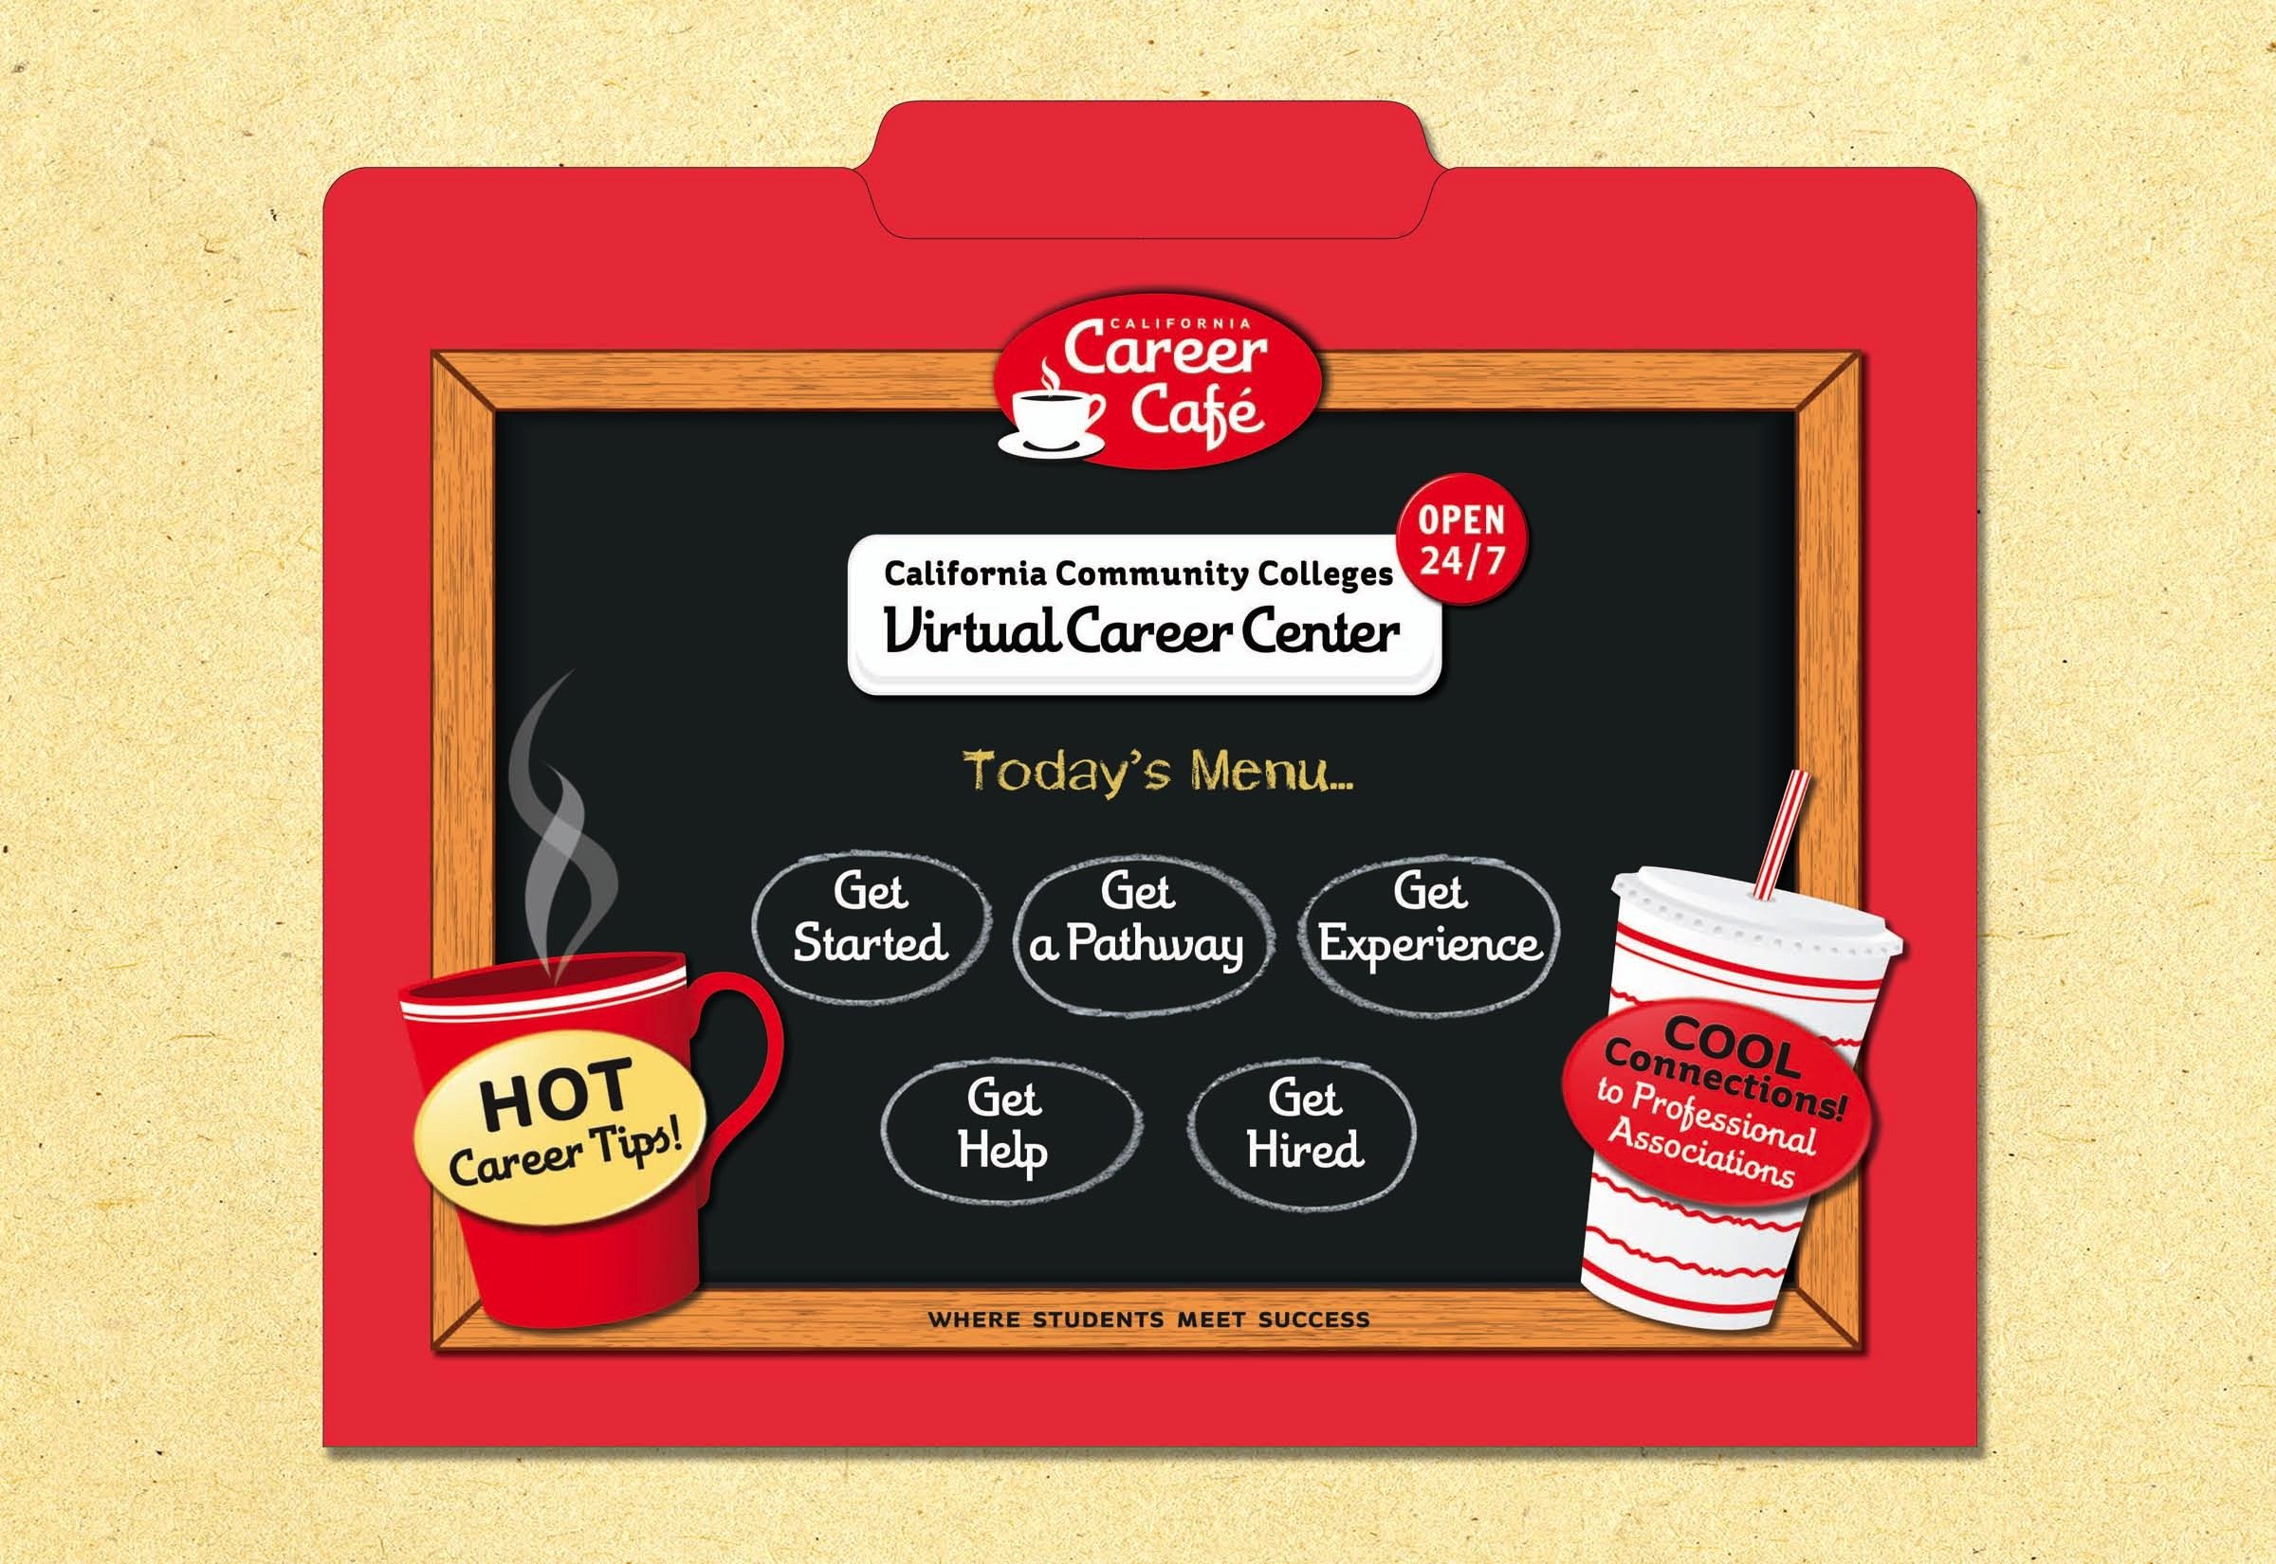
Notes:
To help you get acquainted with the site and all it has to offer, you received a Career Café folder. It has a variety of materials related to the site. As we go through our program, we will introduce you to each section to give you a “taste” of what’s on the Career Café menu.

Slide 5
Notes:
The first thing we want you to see is the Career Café Student Map. This map is designed to get students to the site. Side one of this interactive student guide gives students information about the site and engages them in a couple of career activities.
There is a career quiz in the upper right hand corner . There is a Pathways activity, in the bottom left. This exercise helps students link “Pathways” to real world jobs and people.

Slide 6
Notes:
The other side of the Career Café student map introduces students to Professional Associations and outlines some of the benefits for connecting with one. There are a couple of activities to get students thinking about these organizations and what they have to offer.
Your college can add their own stickers to these maps to encourage students to come to your campus career center. There is also a QR code so students can quickly access the site.

Slide 7
Notes:
Back on the Home Page of the Career Café, students have lots of options depending on what they need and want. To give you an overview of the site, let’s take a look at the site map.

Slide 8
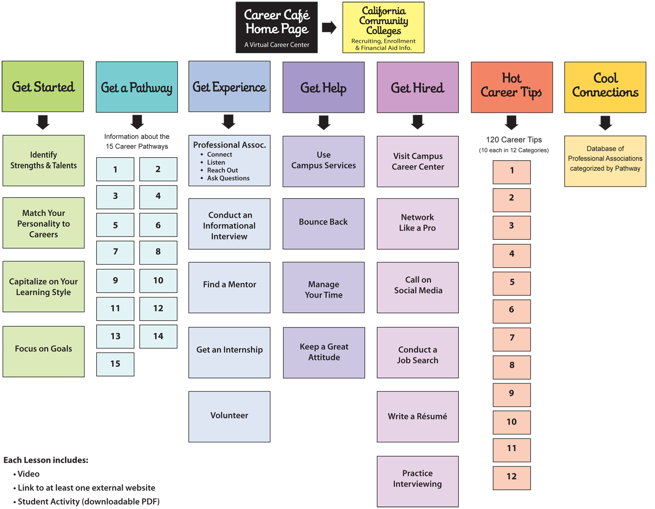
Notes:
This site map is like the table of contents. On this map you can see how the site lays out and the names of the 39 lessons students can access.

Slide 9
5 “Get” Sections — 39 Lessons
Hot Tips — 120 Tips
Cool Connections — database with hundreds of Professional Associations
Notes:
Besides the 5 “get” sections, there are some great hot career tips and hundreds of cool connections to Professional Associations.

Slide 10

Notes:
To see just how the “Get” sections work, let’s take a look at “Get Started.”

Slide 11
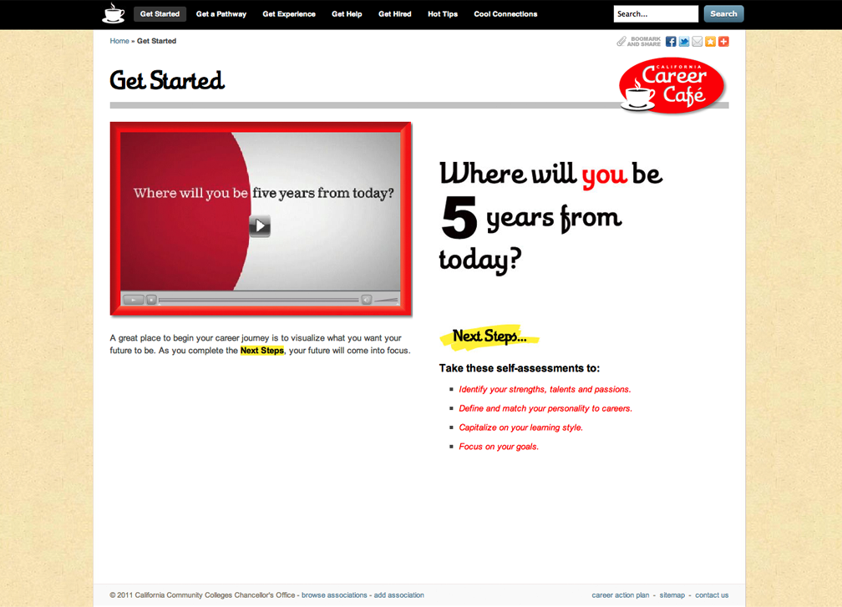
Notes:
On the “Get Started” landing page there is an inspirational video and a list of the four lessons that make up this section. A 2-minute video…”Five” is meant to give students some “food for thought.”

Slide 12

Notes:
(Starts automatically. Not connected to the Internet.)
Here’s the video…It’s from a company called Compendium that designs a variety of inspirational gifts and writes beautiful books.

Slide 13
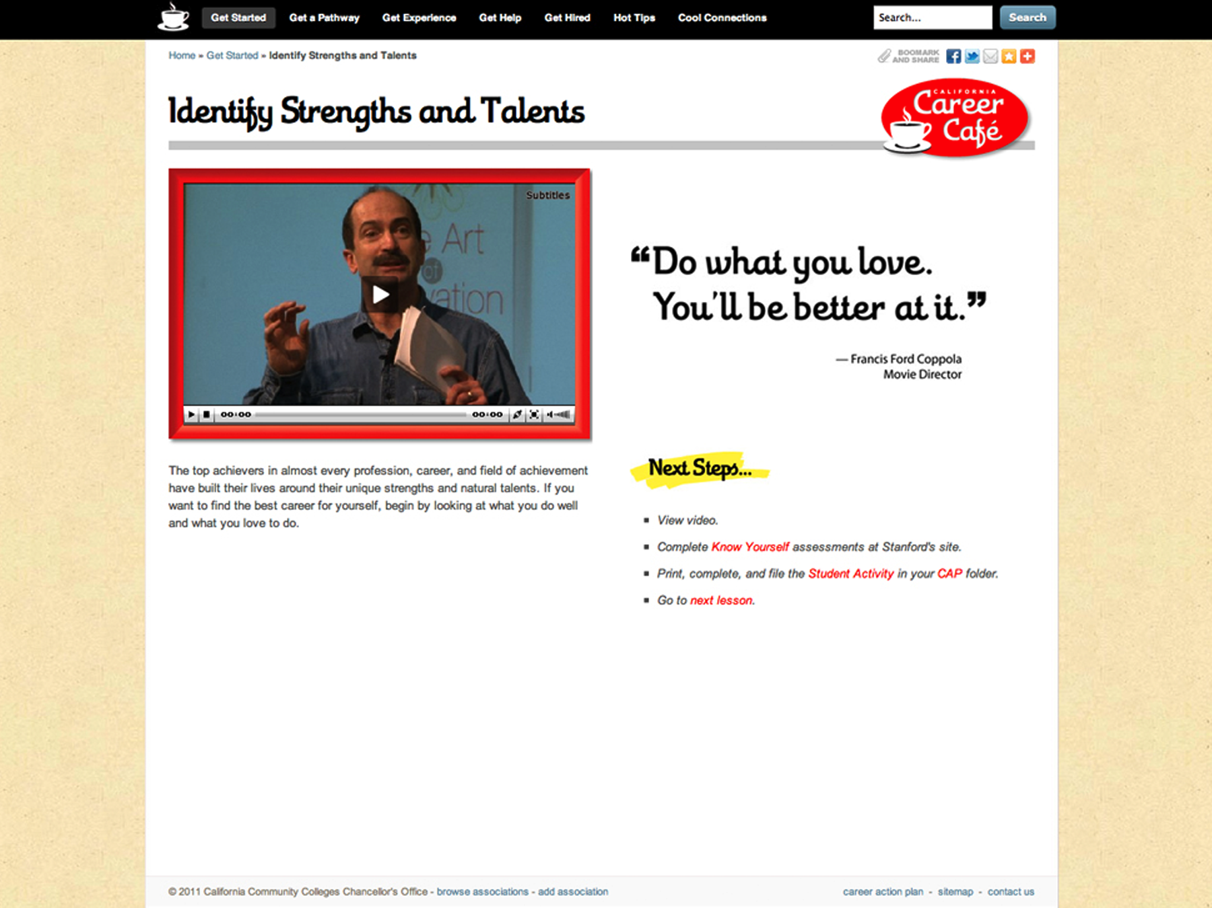
Notes:
From the landing page, we can click on any of the four lessons. Each of the 39 lessons in the café includes a video, outside link(s) and a student activity. Want to hear IDEO founder, Tom Kelley’s, advice?

Slide 14

Notes:
(Internet Required for this Video. Click to start.)
Kelley suggests students do what they love…AND something that people will pay for…

Slide 15
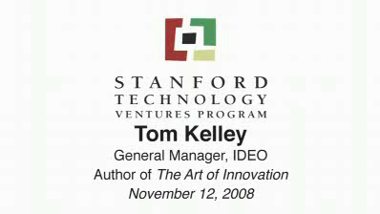
Notes:
(Not Internet Connected. Will Start Automatically.)
Kelley suggests students do what they love…AND something that people will pay for…

Slide 16
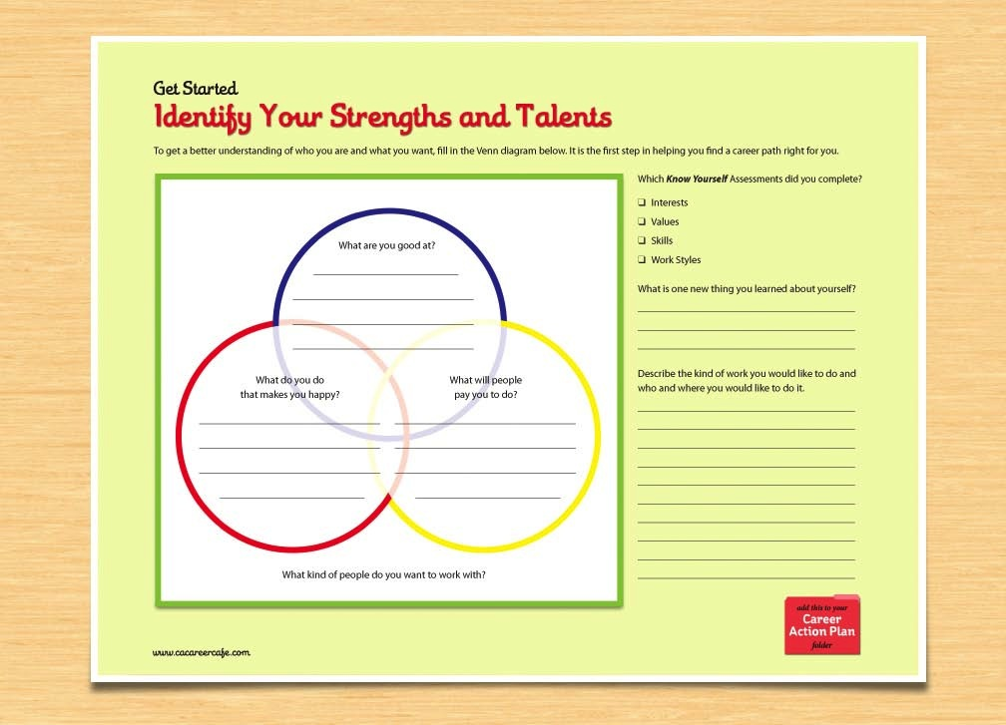
Notes:
Because we want students to DO something with the information in each lesson, there is a printable student activity for them to try. This one is in your folder. Take a few minutes to fill in your three circles.

Slide 17
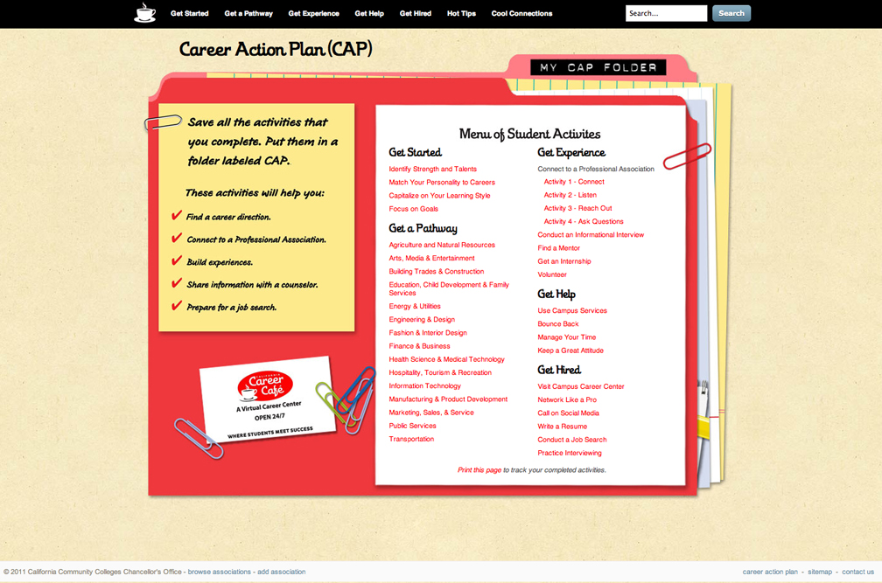
Notes:
Students are encouraged to keep track of the lessons they complete and the information they gather. We suggest they keep a Career Action Plan folder and to use this CAP worksheet to check off their lessons. Find your CAP page in your folder and mark off the activity we just completed.

Slide 18

These 4 “Gets” use same format
“Get a Pathway” is unique
Notes:
The Get Started, Get Experience, Get Help, and Get Hired are all organized the same way. But the Get a Pathway is arranged a little differently.

Slide 19
Notes:
The Get a Pathway section identifies career opportunities in 15 of California’s growing industries.

Slide 20
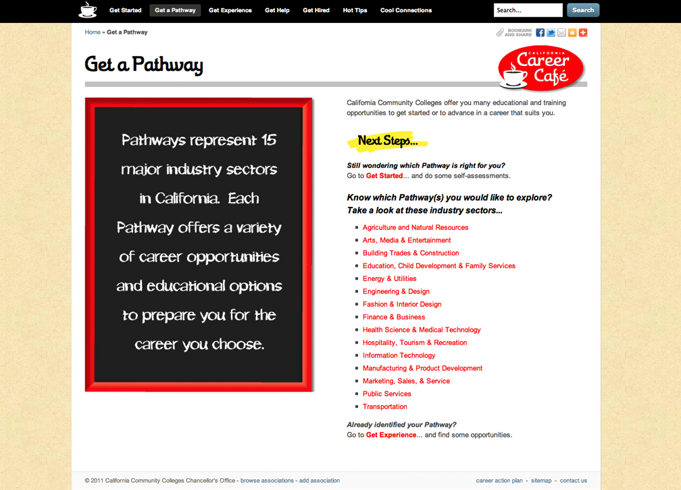
Notes:
On the Pathway landing page are links to the 15 Pathway pages. Let’s take a look at the Marketing, Sales and Service sector to give us a better idea of what students will find.

Slide 21
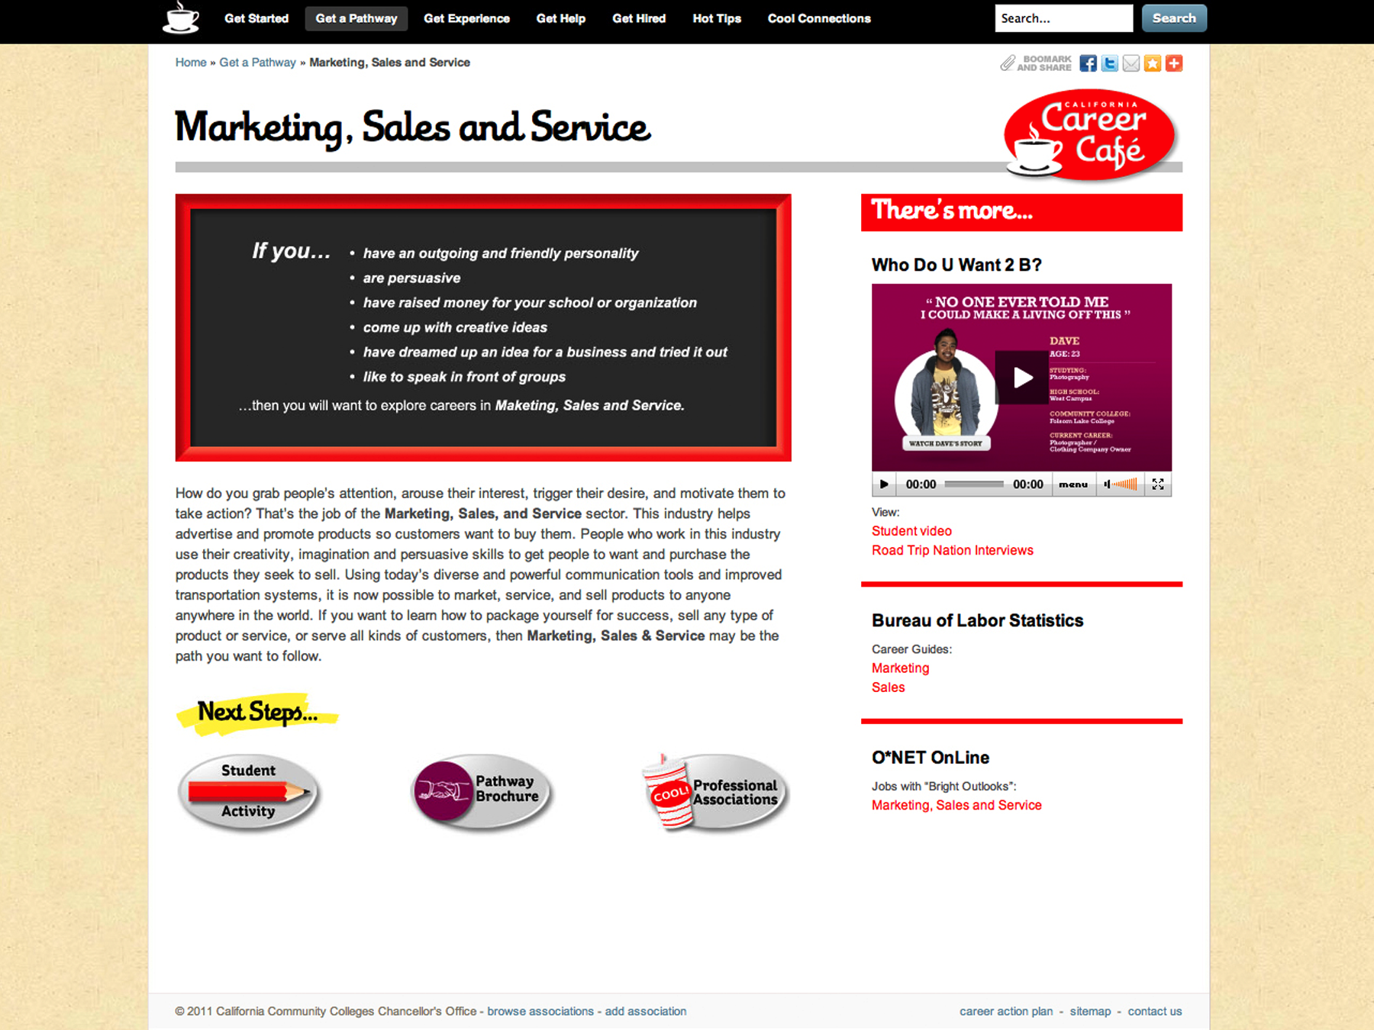
Notes:
There is general information about the industry.
There are videos from Who Do U Want 2 B and Road Trip Nation.
There are links to the Department of Labor.
In addition, there is a printable student activity.

Slide 22
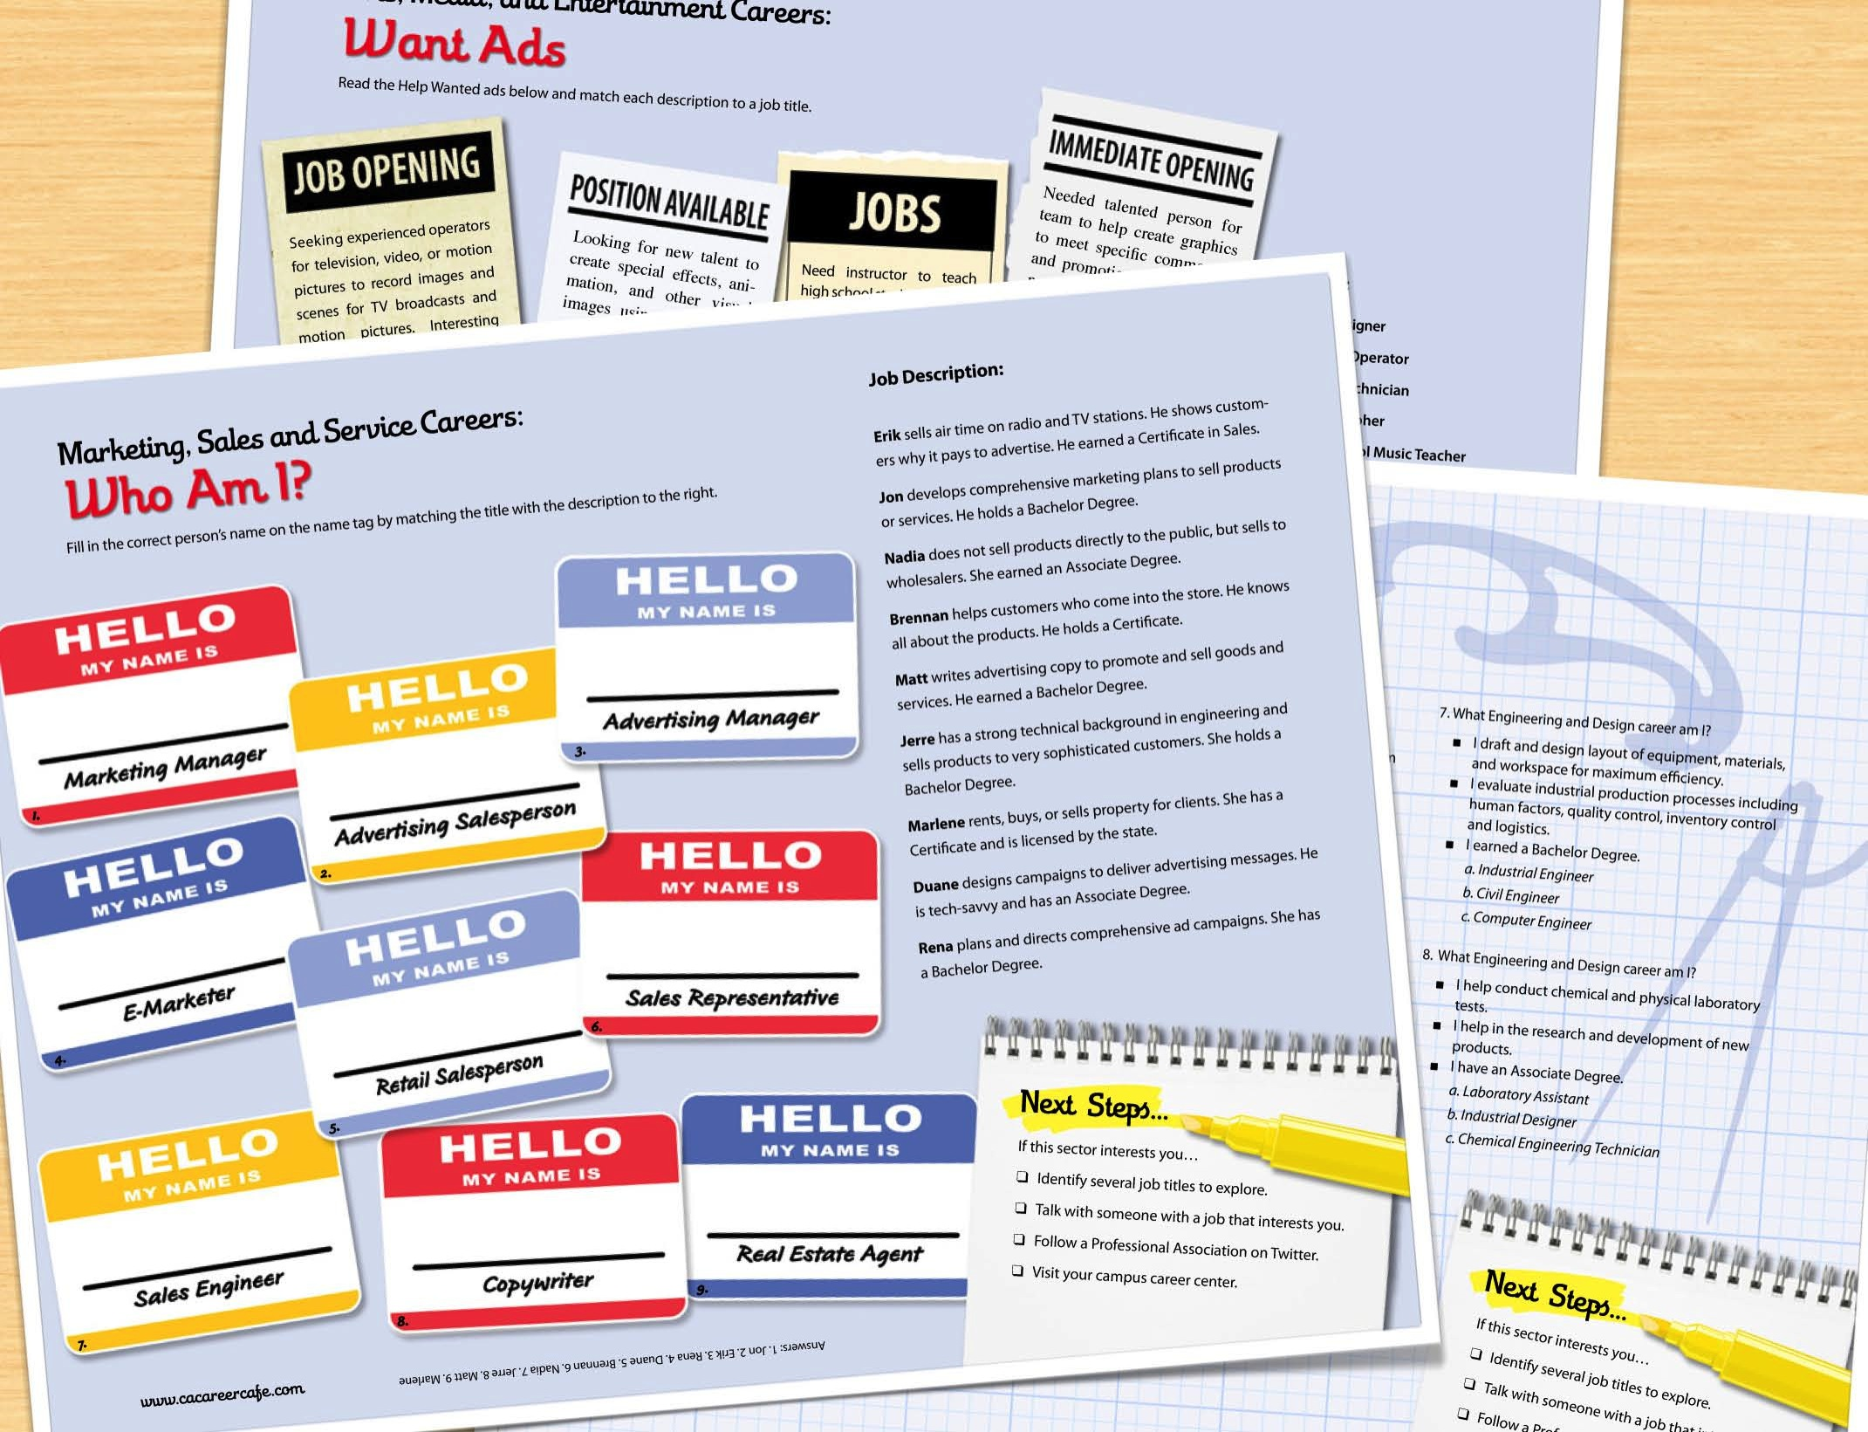

Notes:
The student activity included in each Pathway is designed to increase students’ awareness about the variety of jobs in that Pathway.

Slide 23
Notes:
There is also a Pathway brochure students can review and print.

Slide 24


Notes:
These great industry brochures were developed by the State Center Consortium.

Slide 25
Notes:
To get students connected to Professional Associations in each Pathway, they can link to this database.

Slide 26
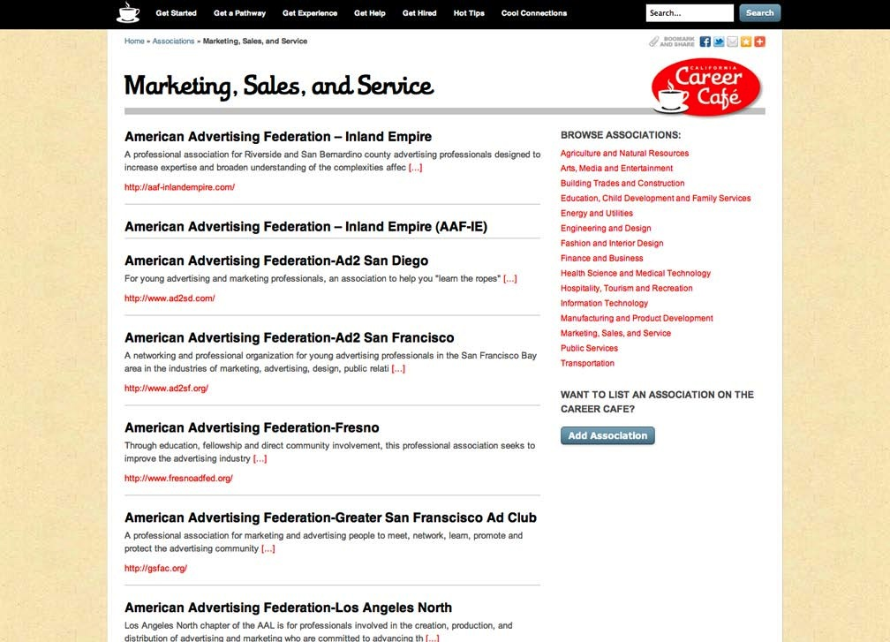
Notes:
The Professional Association database will link students to organizations that interest them. It will help students gather information about different Professional Associations. And it will provide them with the contact information they need to make a connection.

Slide 27
Notes:
For some excellent hot career tips…you can just click on the red mug.

Slide 28
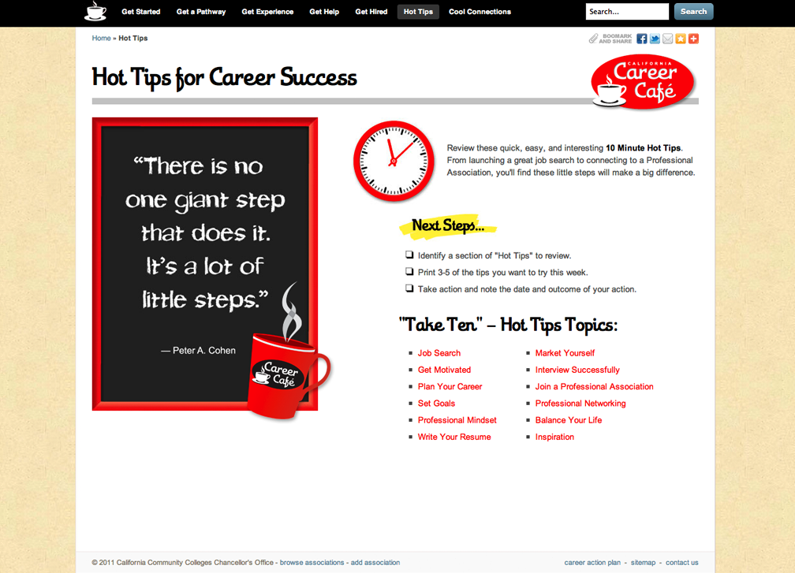
Notes:
These tips were developed for us by Kate Brooks, a career counselor and author. There are 12 topics and each one has 10 tips. Join a Professional Association is just one of the topics.

Slide 29
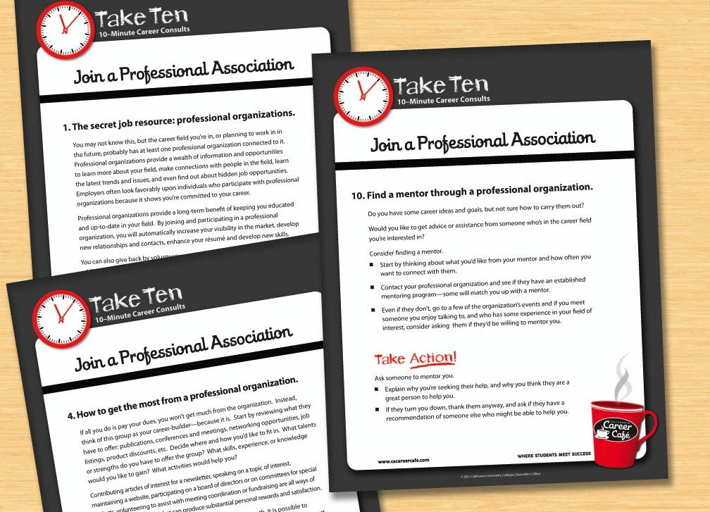
Notes:
These tips offer practical advice. They are printable and include “take action” suggestions.

Slide 30
Notes:
Back on the menu, Cool Connections links directly to a growing database of Professional Associations.

Slide 31
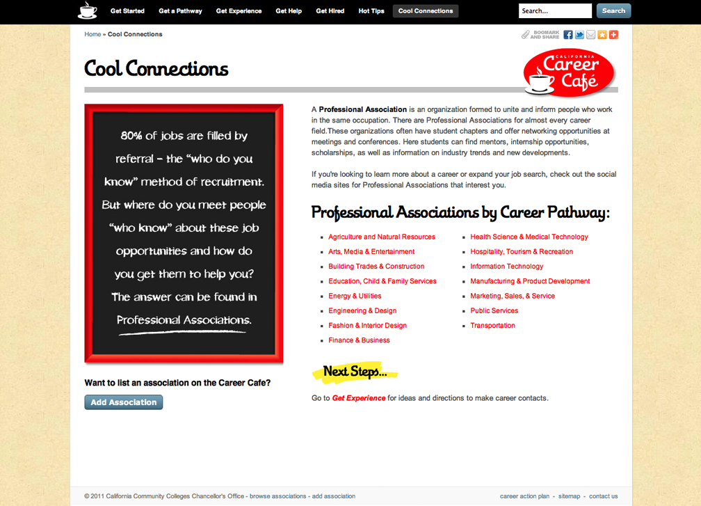

Notes:
Connecting with Professional Associations will help students transition from the classroom to the workplace. They can build their networks, find scholarships, get an internship, choose a mentor and get some great job leads.

Slide 32
Notes:
(Internet Required for this Video. Click to start.)
This 1-minute video will give you more information about the value of Professional Associations.

Slide 33

Notes:
(Not Internet Connected. Will Start Automatically.)
This 1-minute video will give you more information about the value of Professional Associations.

Slide 34
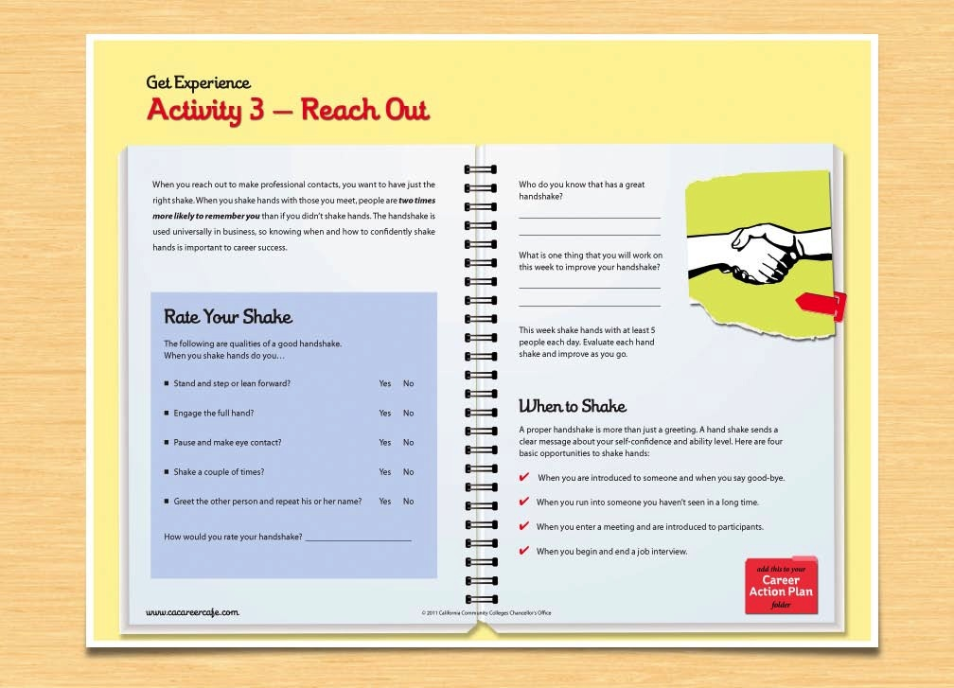
Notes:
This is just one of the activities students will find on the site to help them Reach Out and connect with a Professional Association. This one is also in your folder, so let’s give it a try.

Slide 35
Notes:
I think you’ve gotten a good taste of what students will find at the Career Café. It’s the place they can assess their strengths, explore their options and connect with a Professional Association. And best of all, its open 24/7.

Slide 36
What’s Next?
Notes:
Now the big question is how can your college use this site to help your students? How can you add it to the great resources you already have for your students? What are your next steps?

Slide 37
Contact Us
Susan Coleman
scoleman@occ.cccd.edu
Rita Jones
rjones@occ.cccd.edu
Notes:
We are so happy you stopped by the Career Café. Here is our contact information so you can reach us. Thanks so much!

